Slide 1

Comprehensive Explainable AI for Melanoma Detection: Integrating Grad-CAM and Meta Learner
PRESENTED BY :
RITWIK DUBEY - 22070243038

Slide 2
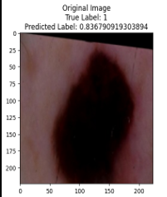
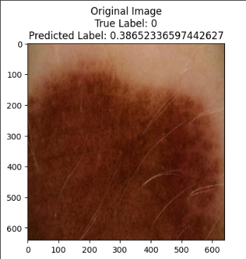
INTRODUCTION :
Importance of Early Melanoma Detection:
Melanoma is a deadly form of skin cancer that can be fatal if not detected early.
Early detection significantly improves the prognosis and chances of successful treatment.
Hence, accurate and timely detection of melanoma is critical for saving lives.
Project Objectives and Methodologies:
The project aims to develop robust machine learning and deep learning models for melanoma detection.
Utilizing deep learning CNNs and XGBoost models, along with interpretability techniques like Grad-CAM ,LIME & SHAP , the project seeks to achieve accurate and explainable predictions.
By analyzing model performance, interpretability, and feature importance, the project aims to contribute to the advancement of melanoma detection techniques.
Melanoma
Benign

Slide 3
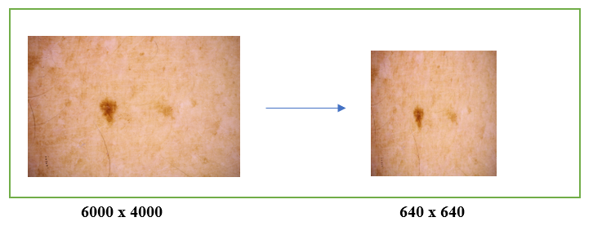
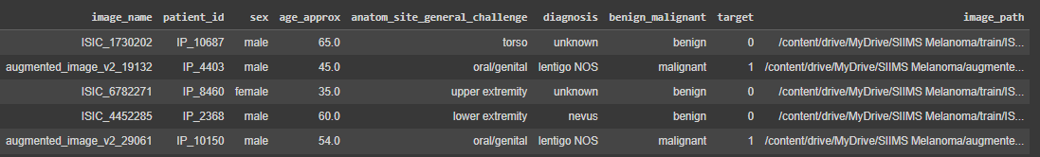
Dataset Overview:
Data Collection:
The dataset was obtained from the SIIM-ISIC Melanoma Classification competition on Kaggle.
Images were initially high resolution (6000 x 4000 pixels) but were resized to 640 x 640 pixels for computational efficiency.
Metadata is stored in a CSV file, including patient ID, sex, age, anatomical site, diagnosis, and the target variable indicating melanoma presence.
Image Resolution Adjustment

Slide 4
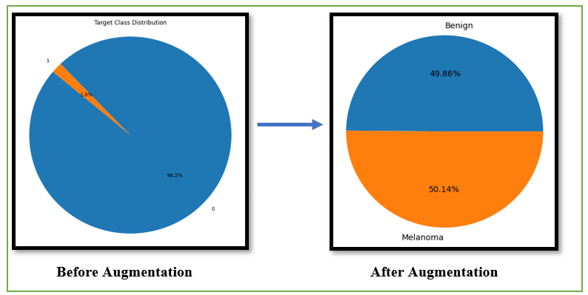
Data Preprocessing, Augmentation, and Train-Validation Splitting:
Addressing Class Imbalance:
Original dataset: 584 melanoma cases out of 33,126 records.
Augmentation techniques used to balance the dataset.
Resulting balanced dataset: 32,720 melanoma cases and 32,542 benign cases.
Dataset Augmentation:
Synthetic data generated to expand melanoma cases.
Augmented images lacked original metadata

Slide 5
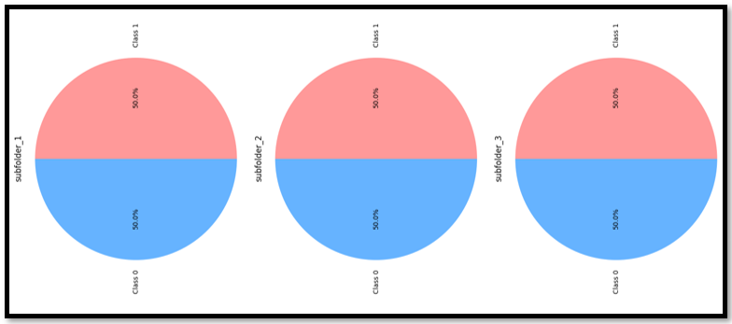
DATASET SPLIT :
Subfolder Creation:
Balanced dataset divided into five subfolders (~14,000 samples each).
Ensured manageable batch sizes for training.
Train-Validation Split:
Stratified splitting within each subfolder.
Maintained 1:1 ratio for melanoma and benign classes.
Prevented bias and ensured reliable model evaluation.
Metadata Imputation for Augmented Images:
Generated synthetic metadata for augmented melanoma images.
Imputed attributes: sex, age, anatomical site, and diagnosis.
Preserved dataset integrity and consistency for robust model training and evaluation.

Slide 6
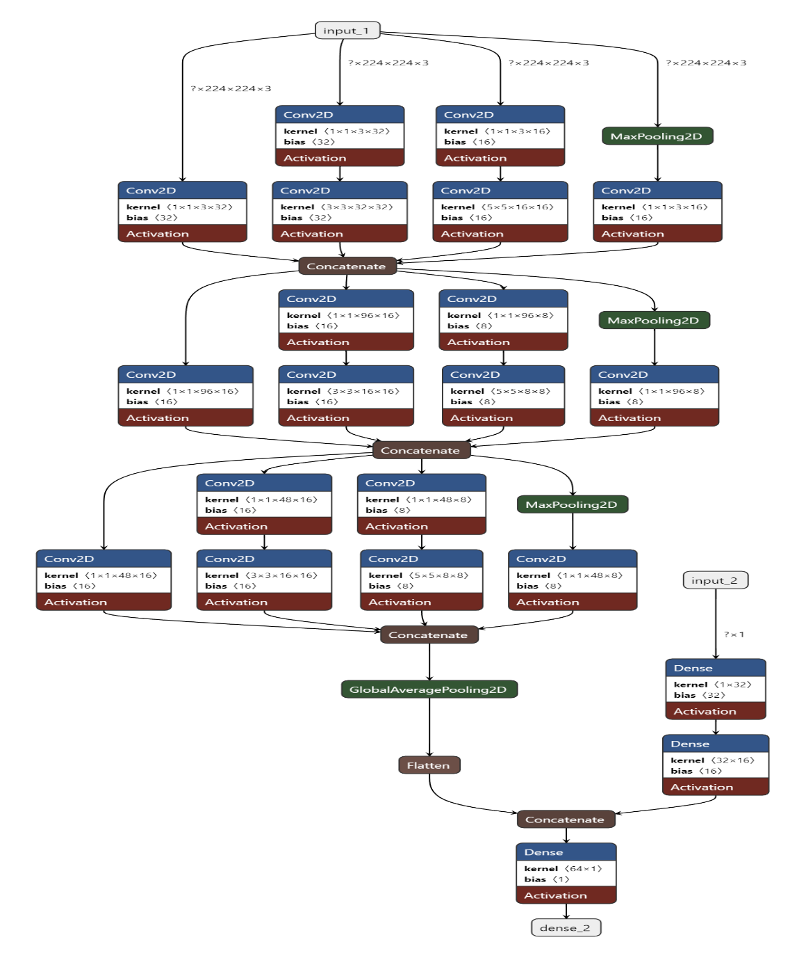
MODEL ARCHITECTURE OVERVIEW
Model 1 - Enhanced Inception Convolutional Blocks with Metadata Integration:
Image Input Processing: 224x224 RGB images.
Metadata Integration: Includes "Age" column.
Model Output: Sigmoid activation for binary classification.
Key Points:
Total Parameters: 31,569.
Loss Function: Binary cross-entropy.
Optimizer: Adam.

Slide 7

Model 2 - Enhanced Metadata Inception Model :
Integration of multiple metadata features: sex, age, anatomical site.
Image branch: Three Inception blocks to extract deep features.
Metadata branch: Dense layers for metadata processing.
Concatenation of image and metadata features.
Key Points:
Total Parameters: 31,793.
Optimizer: Adam.
Loss Function: Binary cross-entropy.

Slide 8
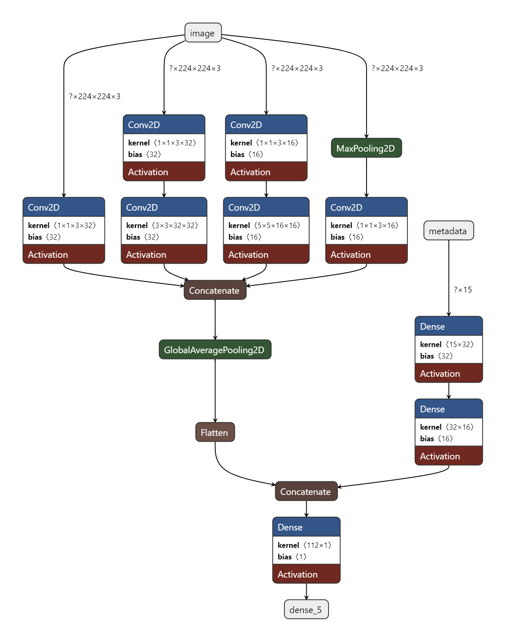
Model 3 - Simplified Multi-Metadata Inception Model:
Streamlined version of “Model-2” for Google Colab.
Single Inception block to reduce computational complexity.
Retains dual-branch structure for images and metadata.
Key Points:
Fewer layers and parameters.
Optimizer: Adam.
Loss Function: Binary cross-entropy.

Slide 9
Model 4 - Image Model with Grad-CAM and LIME Compatibility
(Best Model) :
Image Model Architecture:
The architecture is defined using TensorFlow's Keras API and includes several key components:
Input Layer:
Accepts images of shape (224, 224, 3).
Conv2D Layers:
Three convolutional layers with filters of 32, 64, and 128, and kernel size of 3x3, each followed by a ReLU activation.
MaxPooling2D Layers:
Follow each Conv2D layer to reduce spatial dimensions and prevent overfitting.
GlobalAveragePooling2D Layer:
Reduces each feature map to a single value, significantly decreasing the number of parameters.
Dense Layer:
A dense layer with 128 units and ReLU activation, followed by a dropout layer with a 0.5 dropout rate to mitigate overfitting.
Output Layer:
Final dense layer with a single unit and sigmoid activation function for binary classification.
Image Data Generators:
ImageDataGenerator is used with a rescale factor for normalization.
Custom function create_image_generator yields image arrays and labels batch-wise.
Images are resized to (224, 224) with transformations applied for model input consistency.

Slide 10
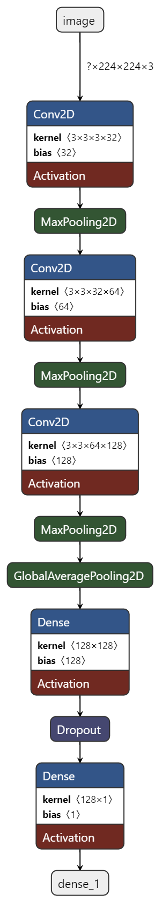
Model 4 - Image Model with Grad-CAM and LIME Compatibility (Best Model) :
Compilation and Training:
Optimization:
Adam optimizer with a learning rate of 0.001.
Binary cross-entropy loss function.
Accuracy as a tracked metric.
Callbacks:
Early Stopping: Monitors validation loss and stops training if no improvement for three epochs, restoring the best weights.
Model Checkpoint: Saves the best model based on validation loss.
ReduceLROnPlateau: Reduces the learning rate if validation loss plateaus, helping escape local minima.
The model is trained for 10 epochs with these callbacks, improving generalization and reducing overfitting.
Improvements and Compatibility:
Model Architecture: Additional convolutional layers and global average pooling enhance feature extraction and reduce parameters before the dense layers.
Dropout Layer: Added to reduce overfitting, increasing model robustness.
Custom Data Generators: Ensures images are processed correctly, maintaining consistency in input shape and preprocessing.
Grad-CAM and LIME Compatibility:
Simplified Architecture:
Global average pooling and distinct convolutional layers improve compatibility with Grad-CAM and LIME.
Interpretability:
These methods visualize regions of the image most influential in the model’s decision-making process.

Slide 11
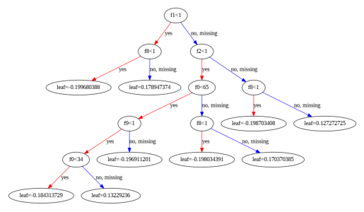
Model 5 - Metadata Model using XGBoost:
Data Preparation:
Dropping irrelevant columns.
One-hot encoding for categorical variables.
Feature and target splitting.
Hyperparameter Tuning with GridSearchCV:
Parameters: max_depth, min_child_weight, gamma, subsample, colsample_bytree, learning_rate.
5-fold cross-validation for accuracy optimization.
Model Training and Performance Evaluation:
Training with best parameters.
High training and validation accuracy.
Confusion matrices for training and validation sets.

Slide 12


Slide 13
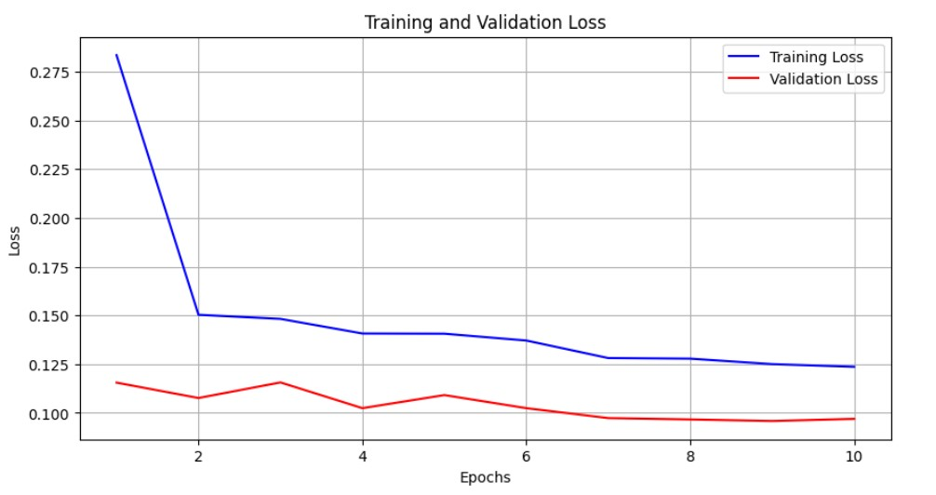
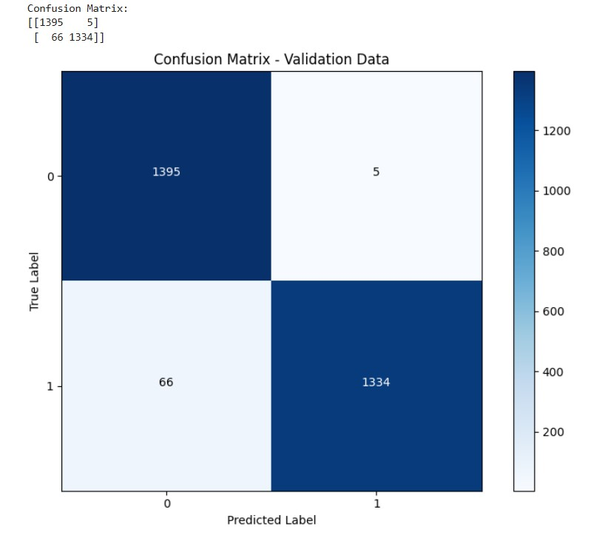
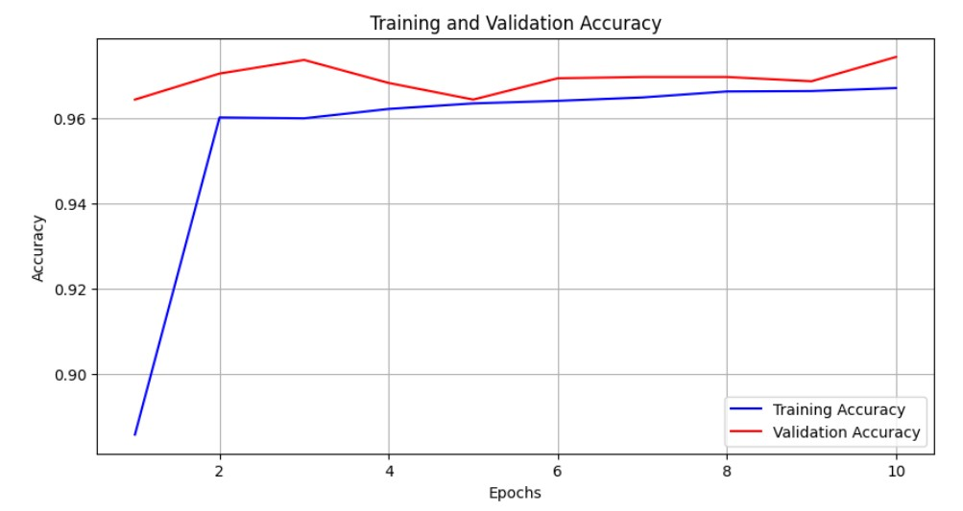
Model-1 Results :
Performance:
Training Accuracy: 96.70%
Validation Accuracy: 97.43%
Confusion Matrix:
Benign Correct: 1395, Incorrect: 5
Malignant Correct: 1334, Incorrect: 66
Training History:
Steady decrease in loss, convergence without overfitting

Slide 14
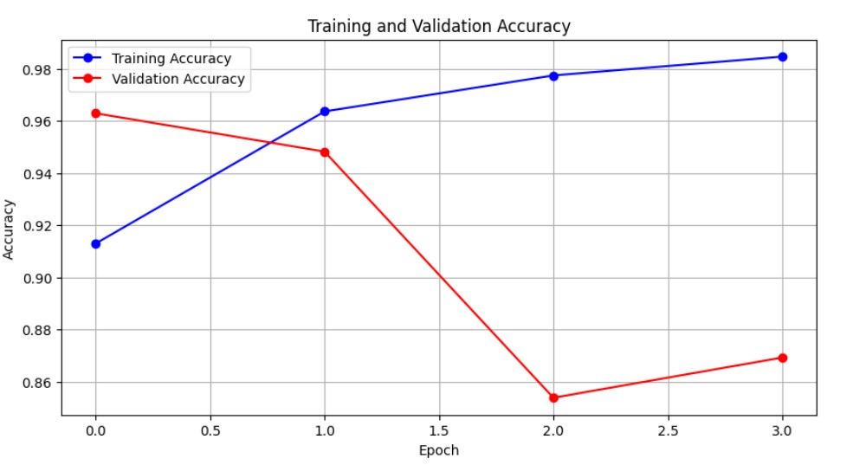
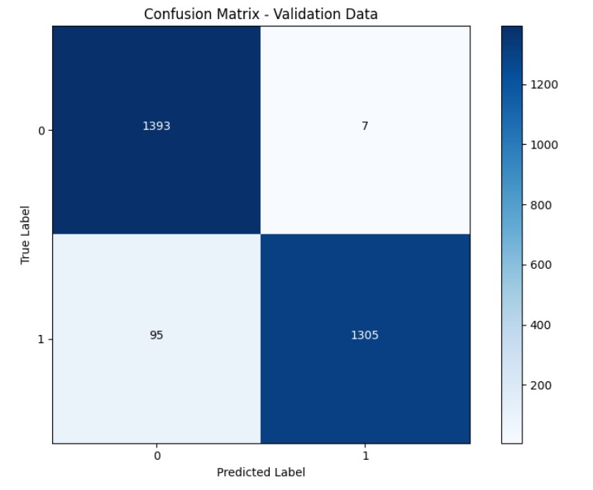
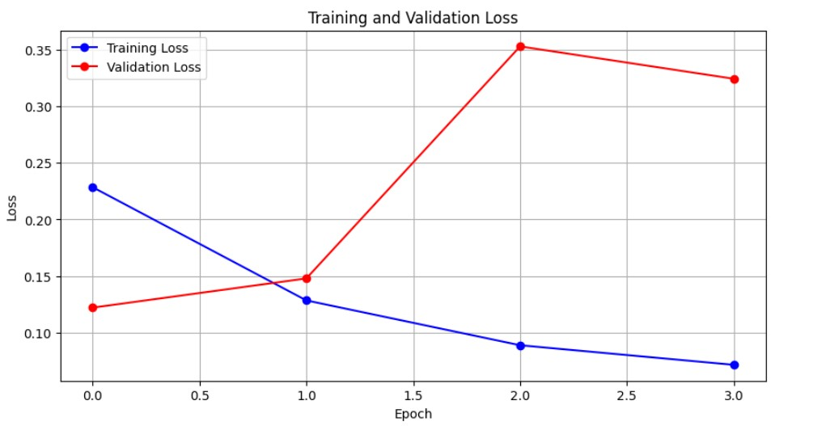
Training Accuracy: 98.46%
Validation Accuracy: Dropped to 86.93%
Model-2 Results :
Performance:
Training Accuracy: 98.46%
Validation Accuracy: Dropped to 86.93%
Confusion Matrix:
Benign Correct: 1393, Incorrect: 7
Malignant Correct: 1305, Incorrect: 95
Training History:
Overfitting observed, validation accuracy decreases after 2nd epoch

Slide 15
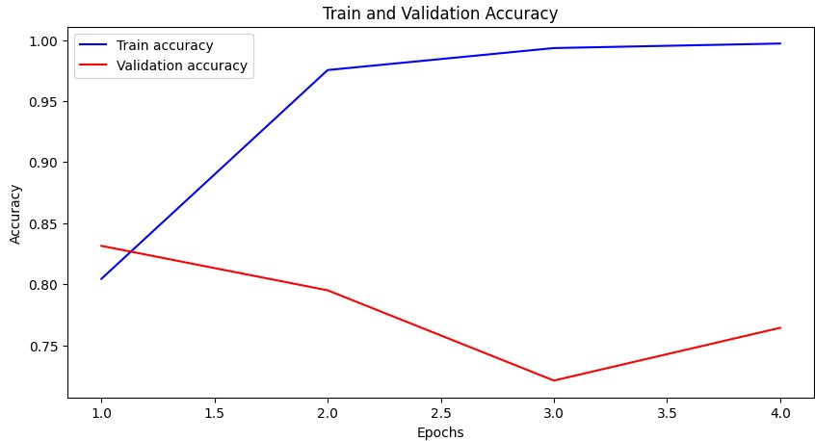
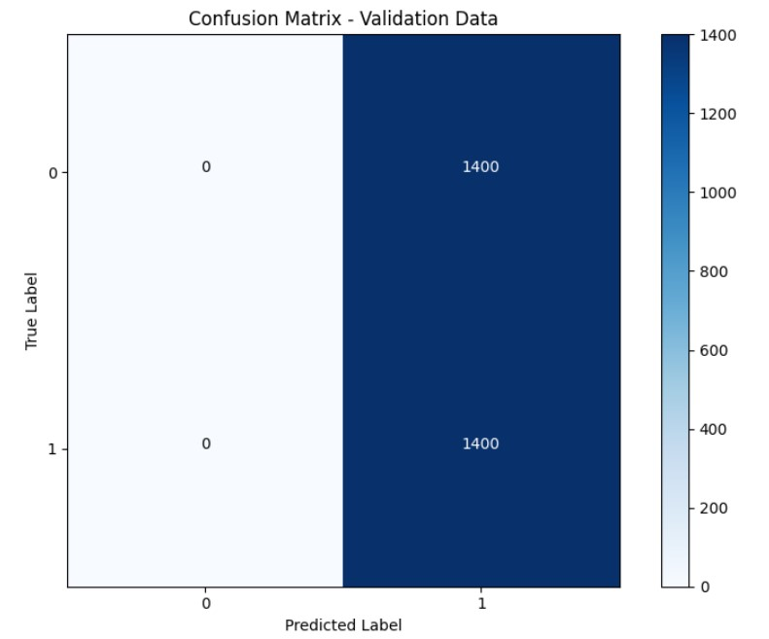
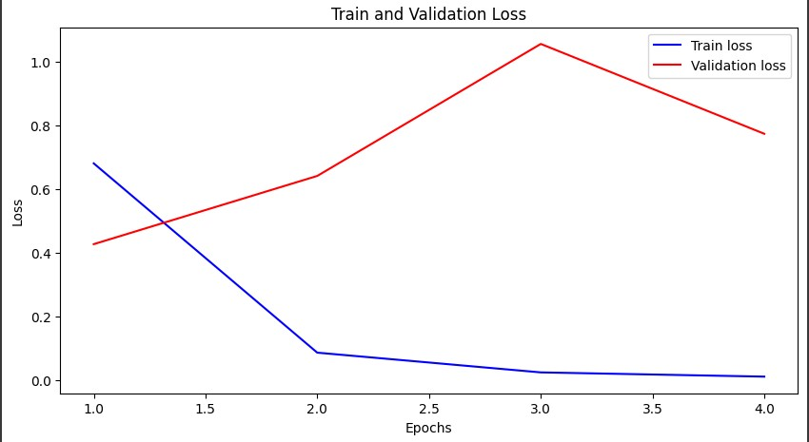
Training Accuracy: 98.46%
Validation Accuracy: Dropped to 86.93%
Model-3 Results :
Performance:
All samples predicted as benign
Validation Accuracy: 76.43%
High Training Accuracy: 99.71%
Confusion Matrix:
Zero True Positives, 1400 False Negatives
Training History:
Significant decline in validation accuracy

Slide 16
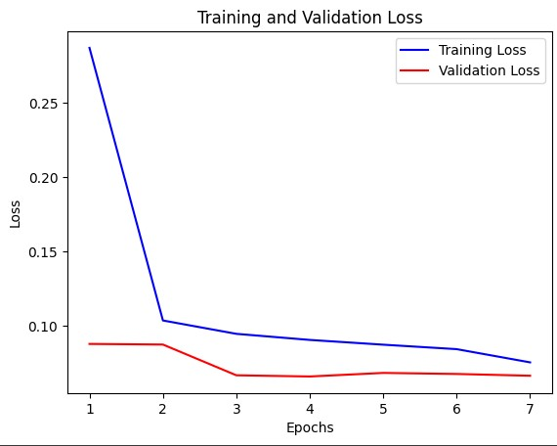
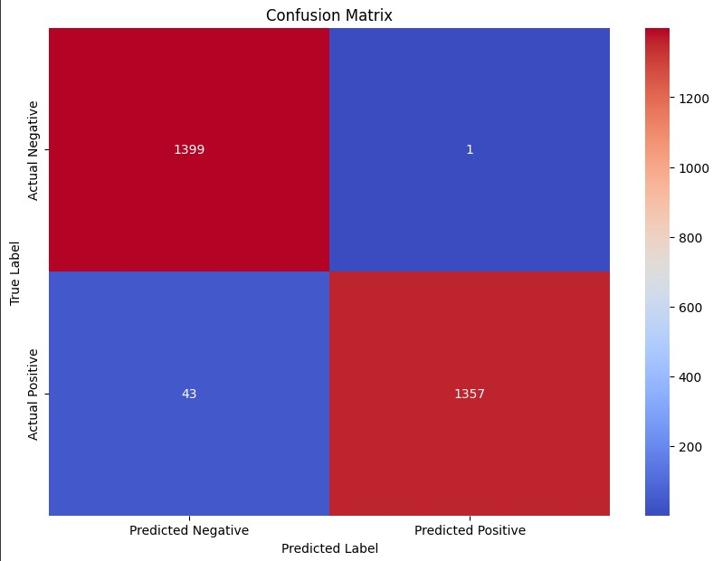
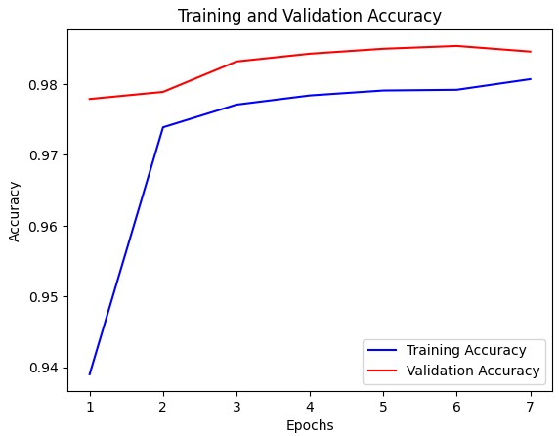
Training Accuracy: 98.46%
Validation Accuracy: Dropped to 86.93%
Model-4 Results (Best Model) :
Performance:
Initial Accuracy: 93.90%
Final Validation Accuracy: 98.54%
Confusion Matrix:
Benign Correct: 1357, Incorrect: 1
Malignant Correct: 1357, Incorrect: 43
Training History:
Consistent improvement in accuracy
Steady decrease in loss, smooth convergence

Slide 17
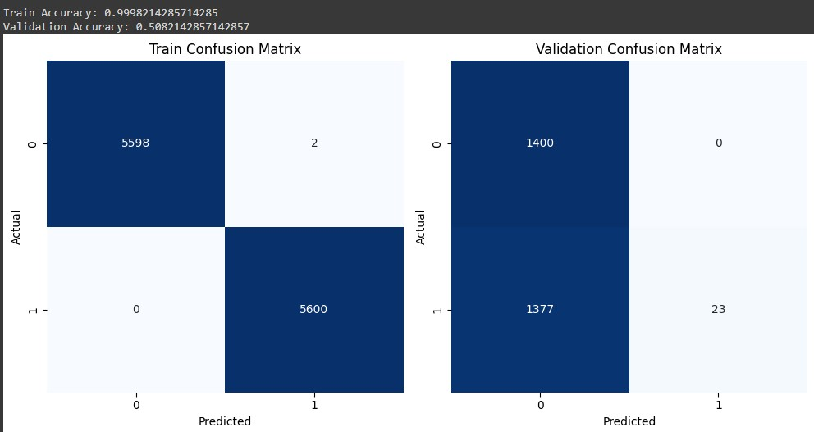
Training Accuracy: 98.46%
Validation Accuracy: Dropped to 86.93%
Model-5 Results (XGBoost for Metadata) :
Performance:
Training Accuracy: 99.98%
Validation Accuracy: 50.82%
Confusion Matrix:
Training: Only 2 misclassified out of 11200
Validation: Failed to classify positive cases
Training History:
Overfitting on training data
Poor generalization on validation data

Slide 18


Slide 19
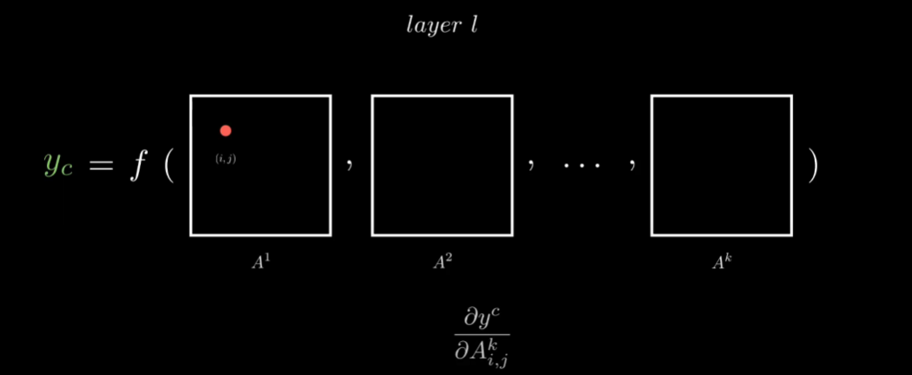
Introduction to Explainable AI (XAI):
Explainable AI aims to make the decision-making processes of AI models transparent and understandable.
Provides insights into how and why models make certain predictions.
Importance of Interpretability in AI Models:
Critical in medical applications where understanding model decisions can impact patient outcomes.
Enhances trust and reliability in AI systems by providing clear reasoning behind predictions.
Assists clinicians in validating AI model outputs and integrating them into clinical workflows.
Overview of Methods Used:
Grad-CAM (Gradient-weighted Class Activation Mapping):
Visualizes important regions in images that influence the model's predictions.
Enhances the interpretability of convolutional neural networks (CNNs).
LIME (Local Interpretable Model-agnostic Explanations):
Explains model predictions by approximating them with interpretable models in the vicinity of specific instances.
Useful for understanding the contribution of individual features to a prediction.
SHAP (Shapley Additive Explanations):
Measures the impact of each feature on the model's output.
Provides a comprehensive understanding of feature importance and contribution.

Slide 20
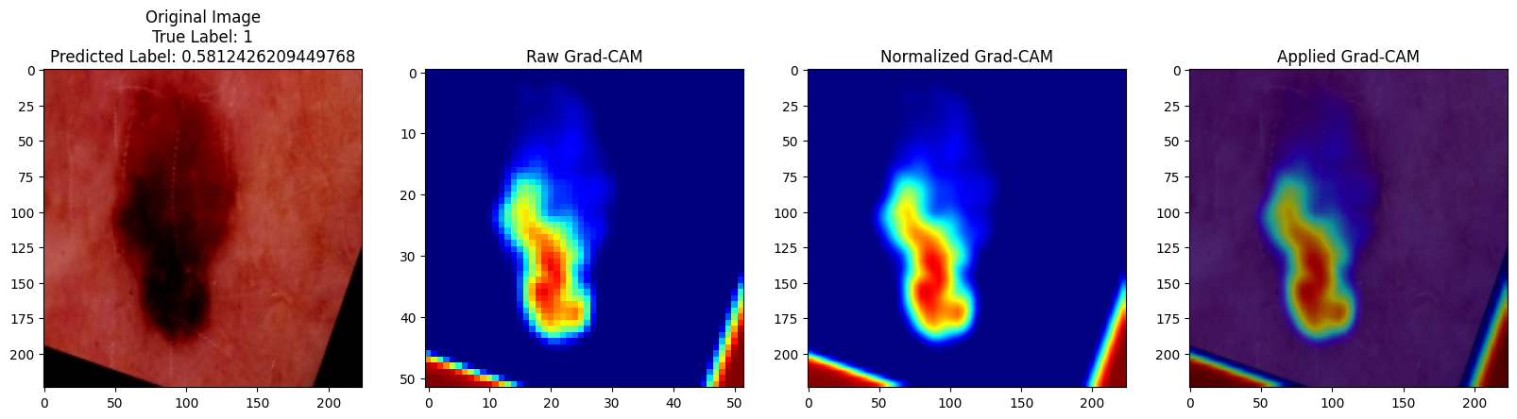
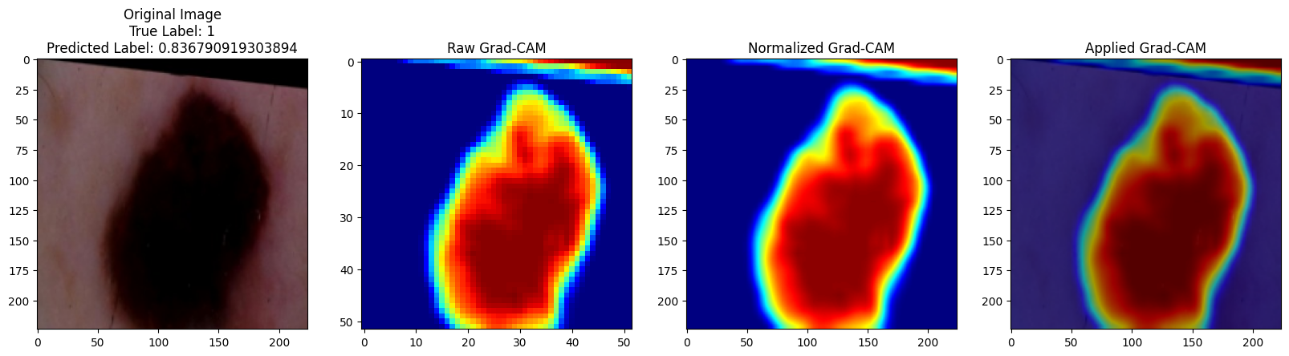
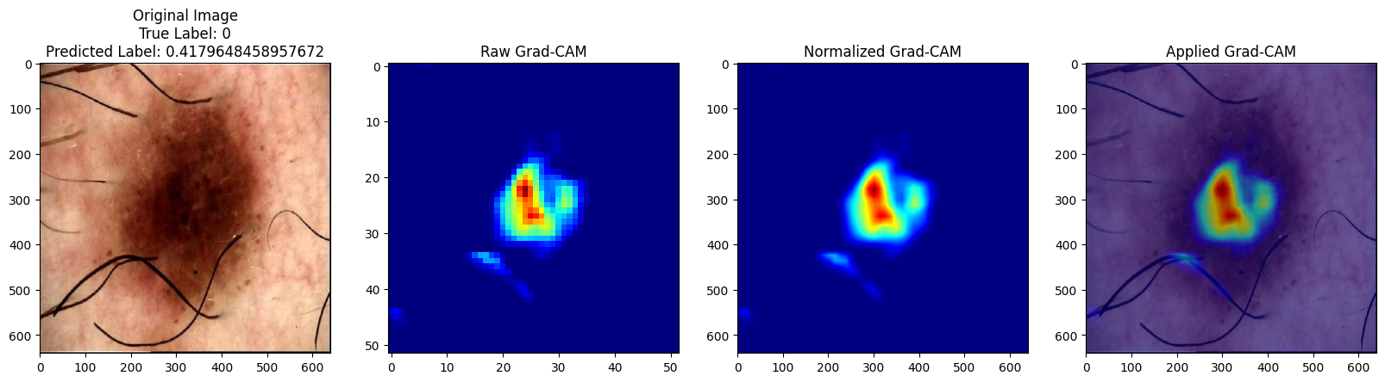
Grad-CAM Analysis (Correctly Classified Images)
True Label: 1 (Melanoma)
Model Prediction: 0.8367 (Correct)
Observation: The Grad-CAM heatmap highlights the region of the skin lesion, indicating that the model is focusing on the relevant area for making its prediction. The bright red and yellow regions in the heatmap correspond to the areas of the input image with the highest influence on the model's prediction of melanoma.
True Label: 1 (Melanoma)
Model Prediction: 0.581 (Correct)
Observation: The Grad-CAM heatmap again highlights the region of the skin lesion, showing that the model is concentrating on the relevant area. The elongated and winding shape of the highlighted region corresponds well with the shape of the lesion in the input image.
True Label: 0 (No Melanoma)
Model Prediction: 0.417 (Correct)
Observation: The Grad-CAM heatmap does not highlight significant regions, suggesting that the model did not focus on areas indicative of melanoma, thereby correctly identifying the absence of melanoma.

Slide 21
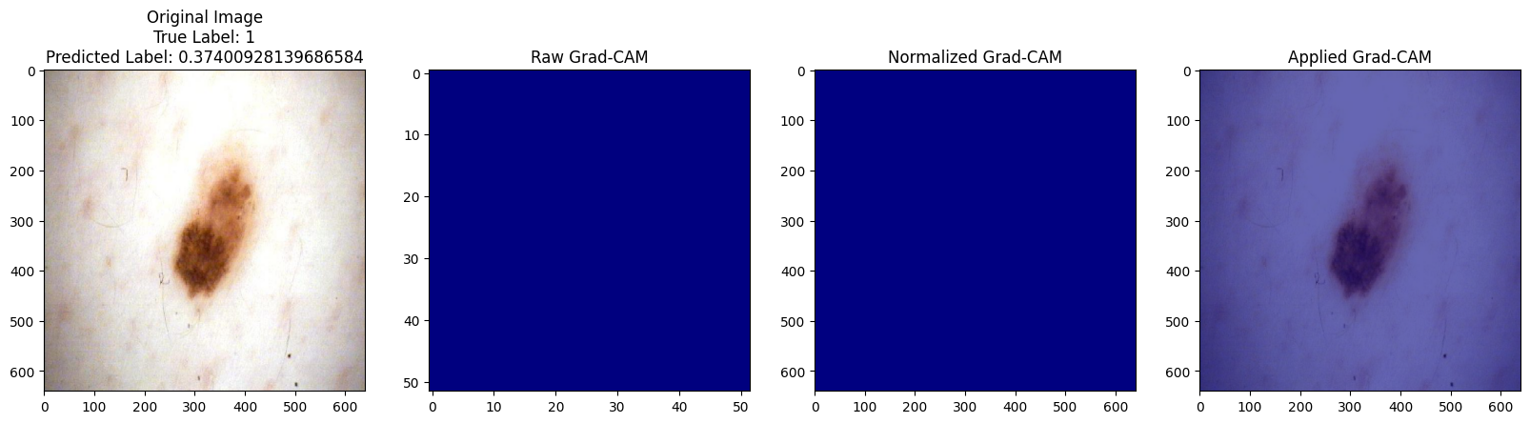
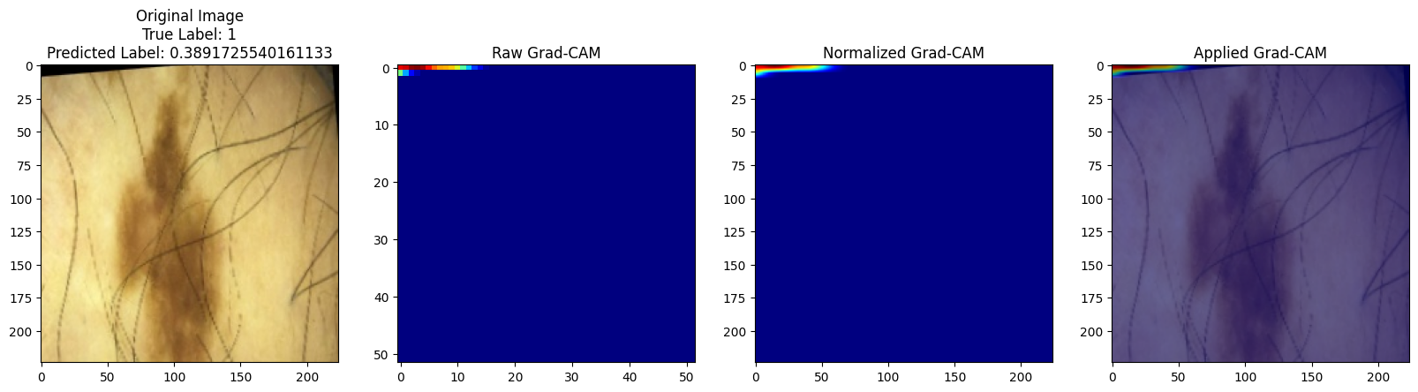
Grad-CAM Analysis (Misclassified Images)
True Label: 1 (Melanoma)
Model Prediction: 0.374 (Incorrect)
Observation: The Grad-CAM heatmap does not highlight any specific region of the input image, indicating that the model did not focus on any particular area to make its prediction. This could be due to the lesion or melanoma being less visually apparent or having features that the model did not adequately learn during training
True Label: 1 (Melanoma)
Model Prediction: 0.389 (Incorrect)
Observation: Similar to Image 5, the Grad-CAM heatmap does not highlight any specific region of the input image. This suggests that the model did not focus on any particular area to make its prediction. The features of the lesion or melanoma may not have been prominent enough, or the model may have struggled to learn the relevant patterns during training.

Slide 22
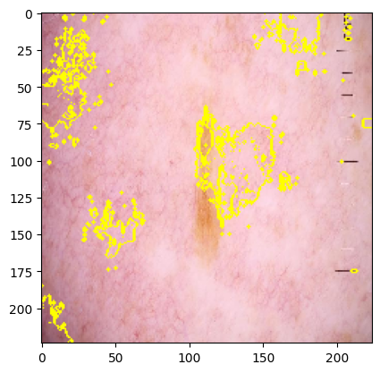
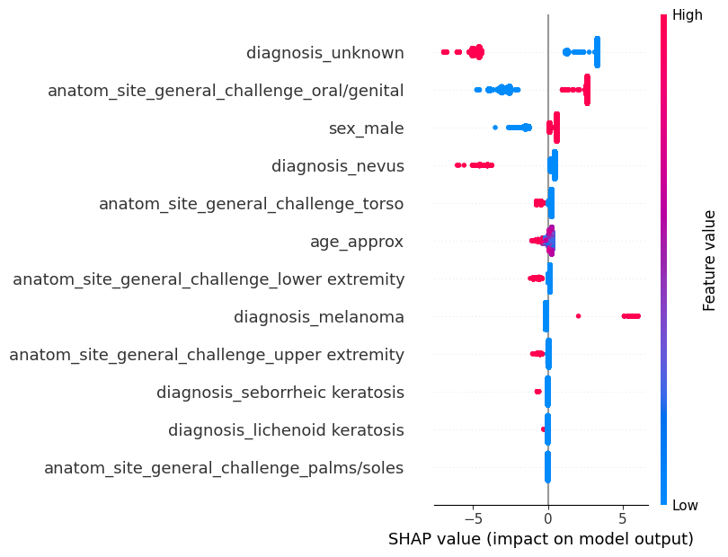
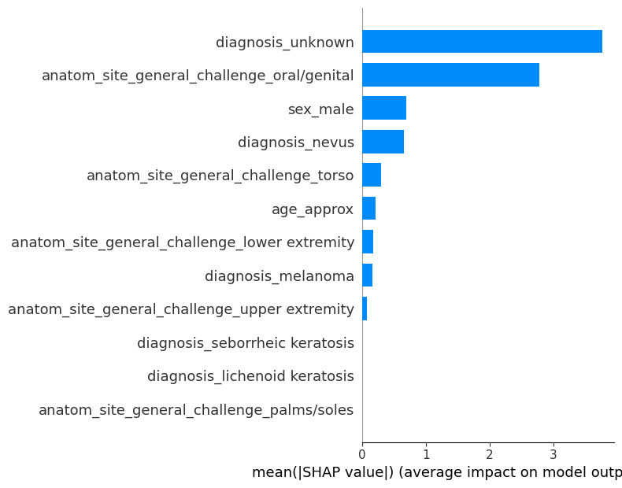
LIME and SHAP Explainers
LIME (Local Interpretable Model-agnostic Explanations):
Highlighted regions in the input image represent the areas that had the greatest positive influence on the model's prediction.
Useful for understanding which parts of an image contributed most to a specific classification decision.
SHAP (Shapley Additive Explanations):
Purpose: Provides a unified measure of feature importance, explaining the output of machine learning models.
Examples:
SHAP Analysis -1: Shows SHAP values for each feature, indicating the impact on the model's output. Features with positive SHAP values increase the probability of the positive class (e.g., melanoma), while negative values decrease it.
SHAP Analysis -2: Displays the mean absolute SHAP values, representing the average impact of each feature across all instances. Higher values indicate more important features.

Slide 23
THANKS

